Slide 1
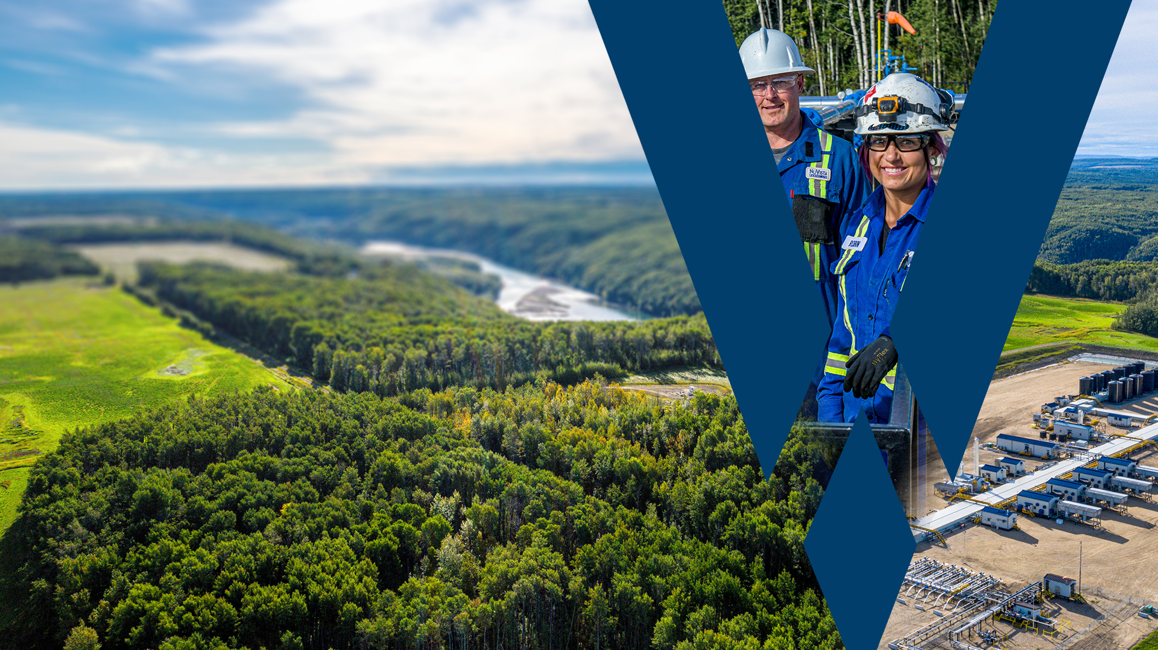

Slide 2
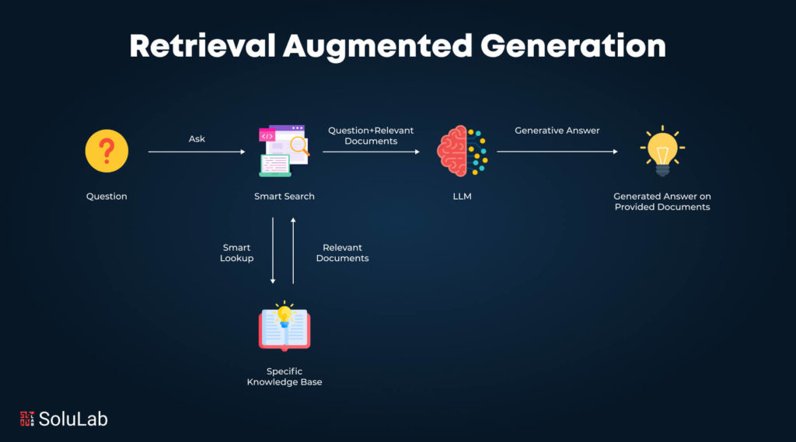
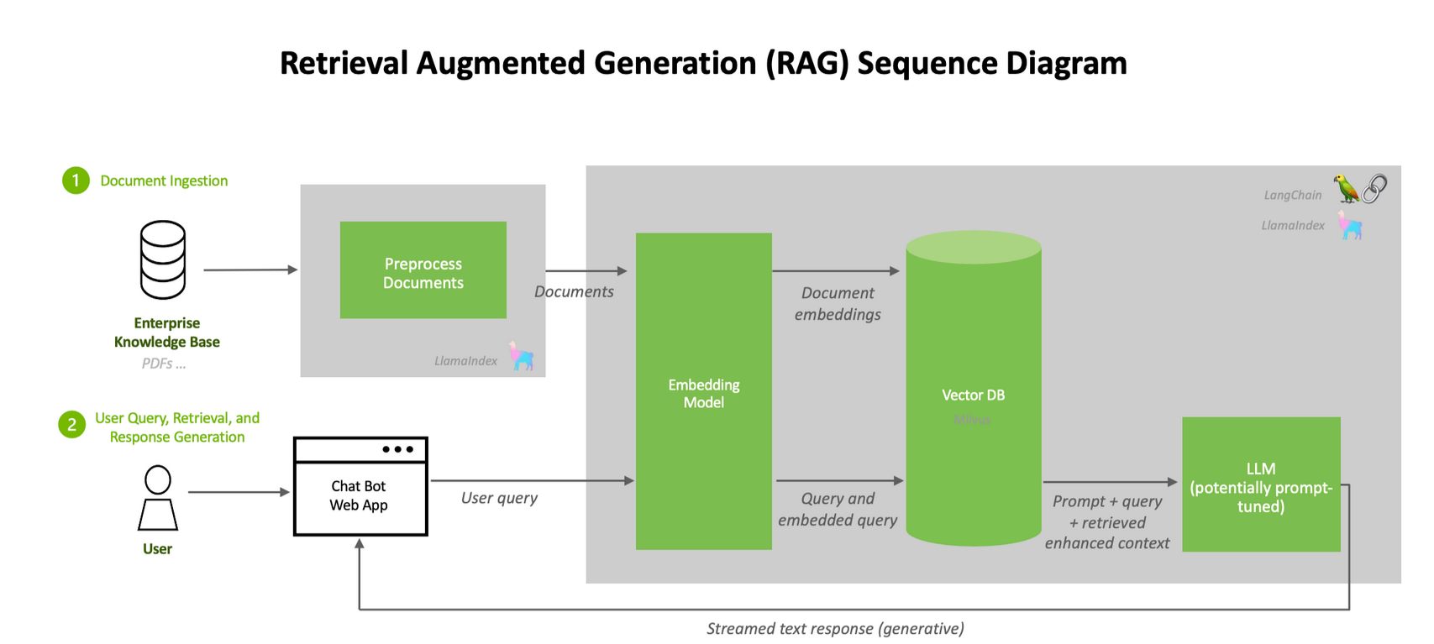
Retrieval-Augmented Generation (RAG)
Current Leading AI Implementation (Most discussed)
RAG combines retrieval (fetching relevant data) with generation (LLM-based text synthesis) to provide context-aware, dynamic responses using both stored and real-time information.
Relevant Use Cases
1️⃣ Land & Lease Docs → Instantly retrieve ownership, expiration, and contract terms (e.g., “Who owns mineral rights for Well XYZ?”) - Presented by Oxy
2️⃣ Well Info → Access completions and production history (“When did Well #456’s start producing?”)
3️⃣ Workovers & Maintenance → Retrieve past interventions, failure causes, and costs (“Last workover on Well ABC?”)
4️⃣ Drilling & Completions → Find offset well data, mud logs, and NPT events (“What mud was used in Well #123?”)
https://www.solulab.com/what-is-retrieval-augmented-generation/
https://developer.nvidia.com/blog/rag-101-demystifying-retrieval-augmented-generation-pipelines/

Slide 3
Notable Projects
Stuck Pipe Anomaly - ARC
Developed an ML model for Stuck Pipe Detection using pipe resistivity data to identify anomalies and predict stuck drilling conditions, enabling proactive intervention.
Clustered GAMM to predict EUR’s – Veren
Clustered GAMM (multivariate, non-linear regression) to predict well EURs across three reservoir clusters, training separate models per cluster plus a global model for comparison. Data pipeline: preprocess well data, cluster reservoirs, engineer features, train models, validate, and predict EURs.
Reservoir Geo Characterization ML Application – Tundra
Used ML to analyze key reservoir traits (Resistivity, Reservoir Isopach, Core Permeability), applying functions to quantify each geoparameter and summing unit contributions for a comprehensive subsurface model.
Key traits (Resistivity, Resovoir Isoph, Core Peremeability) Function for each Geo parameter, sum up units
Geo Insights - Birchcliff

